Slide 1
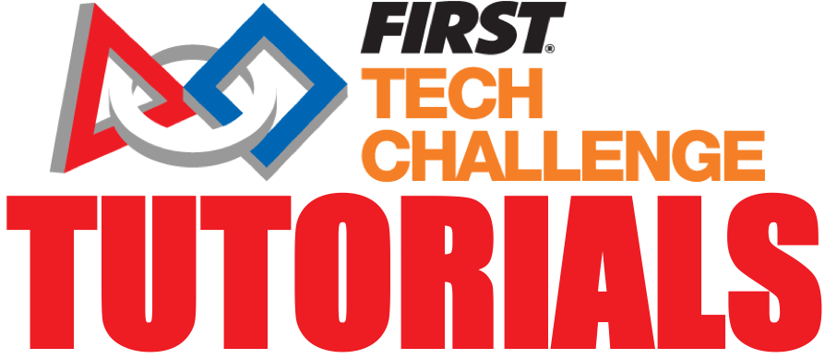
3D Printing
The Antidote - FTC 14320

Slide 2
What is 3D Printing?
A process of creating a three-dimensional solid objects by adding material layer by layer.
Can make products of almost any shape and form
Can create complex geometrical shapes and parts – which may not be able to be manufactured using traditional methods

Slide 3
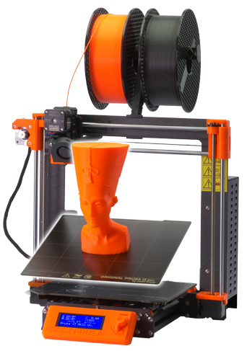
Advantages of 3D Printing
Fabricate 3D models that can be printed in a relatively short period of time
PLA (and most other materials) are strong enough to sustain the rigors of the game
Easy to develop prototypes throughout the Engineering Design process
Can sometimes replace COTS parts to save money

Slide 4
Types of 3D Printers
Cartesian Printer (Bedslinger)
All axes move independently
X axis moves left / right
Y axis moves forward / backward
Z axis moves up / down
Bed moves on the Y axis
Hot end carried on the x axis
The extruder drives the filament into the hot end and gets extruded through the nozzle
X
Z
Y

Slide 5
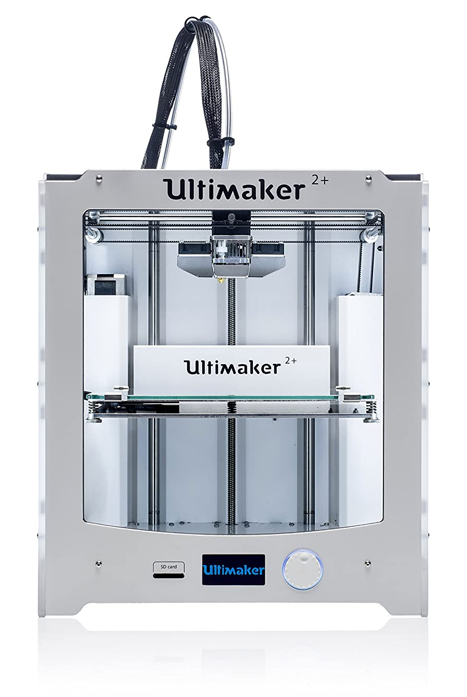
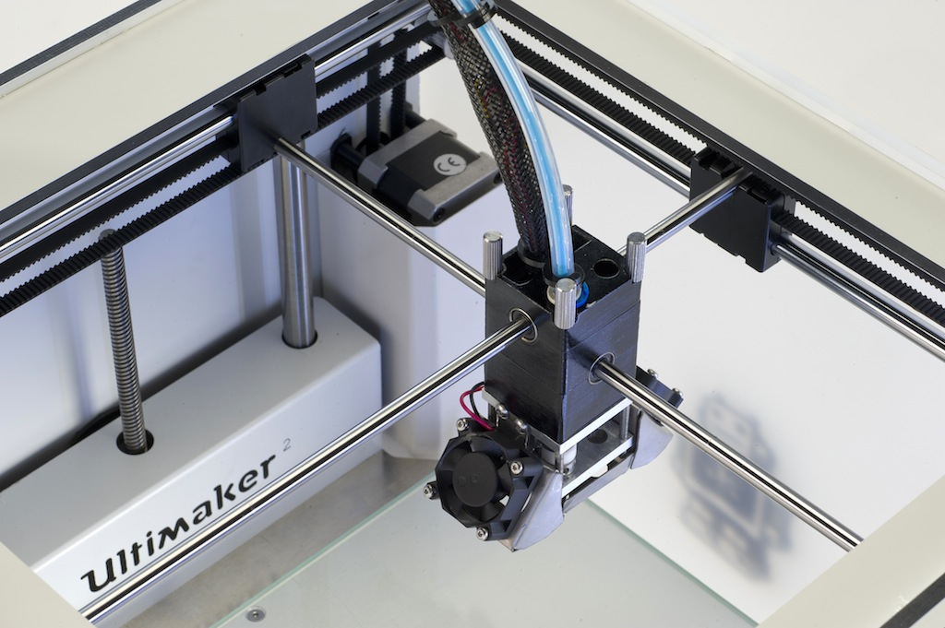
Types of 3D Printers
CoreXY Printer
The X and Y axes move together
Z axis moves up / down
Bed is stationary but moves down with the Z axis
Hot end carried on the X and Y axis

Slide 6
Delta Printer
Features a non-moving circular bed
Instead of axes, the printer uses three arms to move the hot end around
The main advantage over other types of printers is speed
Because it is not very precise, we do not recommend this style of printer

Slide 7
Parts of a Printer
Most 3D printers consist of extrusion-based frames to create rigidity
Bowden Tube or Direct Drive Extruder
Heated Bed
Hot End (melts the filament)
Moving Parts
Stepper motor – Brushless DC motor capable of high precision
Four stepper motors control each axis as well as the extruder

Slide 8
What is Filament?
Filament is a thermoplastic that can be heated up to a certain temperature and extruded to create 3D models
There are several filament types with separate properties
PLA, PETG, ABS, TPU
PLA is the most popular
Filament is typically 1.75 mm, but can be found at a 2.85 mm size
Spools typically contain 1 KG of filament, and cost around $20
Filament can absorb moisture (bad!) so keep them in a dry environment and only open the seal when being used

Slide 9
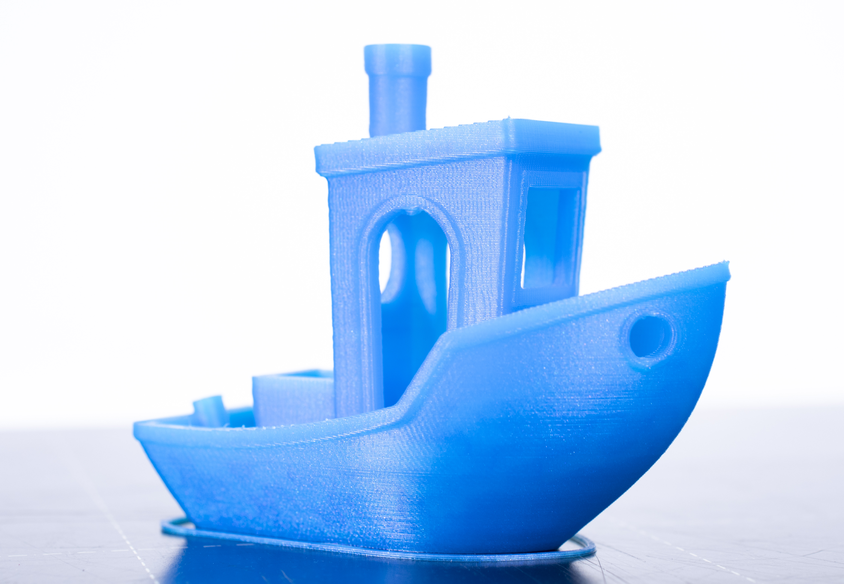
The 3D Printing Process
Create a model using a CAD program such as Solidworks, Onshape or Fusion 360
Save as STL (Surface Tesselation Language) file
Or alternatively download an STL from the internet
Open the STL file in a Slicer such as Cura or PrusaSlicer
Slicers contain the multitudes of settings that you can change in order to get calibrated prints
This is the (sometimes) fun part!
Slicers split the model into many thin layers that will be stacked to create the model
Save as a GCODE file and print!
The printer creates the model layer- by-layer

Slide 10
The 3D Printing Process
Once the heated bed has cooled down, simply grasp the model firmly and snap it off from the platform
If you have a magnetic bed, you can peel the print right off of the surface!
You can use a 3D printing spatula (usually included) and a rubber mallet on the edges of the print to knock it off
You can use flush cutters (usually included) to clean up any messy spots
A heat gun (or hair dryer) can remove any stringing on your model

Slide 11
Recommended Settings
All of these are suggestions: we recommend playing around with the settings to see how to get the best print
Default settings are a good starting point!
Layer Height (how thick should each layer be): 0.20 mm
Should be no more than 80% of your nozzle diameter
The larger the layer height, the faster the print, and the less the resolution
Line Width (how wide is each line): 0.60 mm
Should be larger than your nozzle diameter
Infill (how much material should support the model): 20-50%
Temperature depends on the type of filament you are using

Slide 12
Challenges
Here are a few challenges you may experience as you print!
Bed Adhesion
The model may not stay attached to the bed while printing (bad!)
Some glue can help keep the print on the bed
Bed Leveling
Most printers use manual bed leveling – Turning knobs to level the bed (a printer paper should fit between your nozzle and bed)
A skirt (lines around the model) is a visual indicator if the bed is level
Automatic Bed Leveling Systems (like the BLTouch) makes printing easier

Slide 13
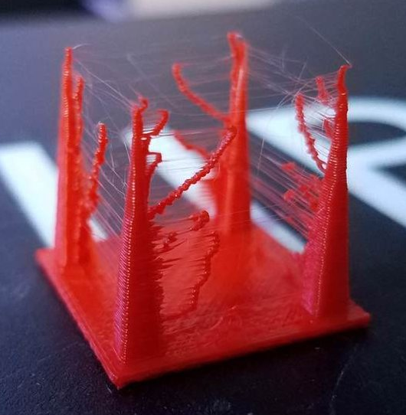
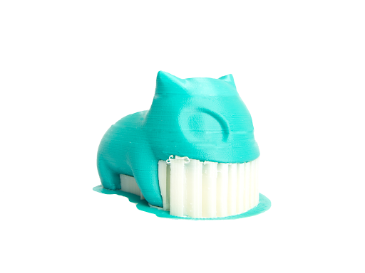
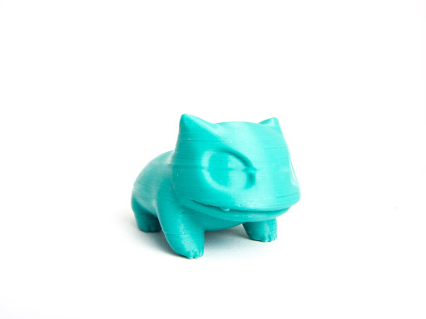
Challenges
Support Material
Models that have overhangs (like in the picture) may require support to print ‘in the air’
Support material can be hard to take off, so it is important to dial in your support settings!
Stringing
Not super prevalent but can be tough when dealing with multiple tall and thin objects.
Try tinkering with retraction, print speed, and temperature.

Slide 14
Calibration Test Prints
XYZ Calibration Cube
This cube acts a test to see if the printer is capable of printing with accuracy
Each dimension should be 20 mm
Can easily check for over/underextrusion or any other problem
3D Benchy
Our favorite calibration print
Tests your printer’s bridging, overhangs, stringing, and other details

Slide 15
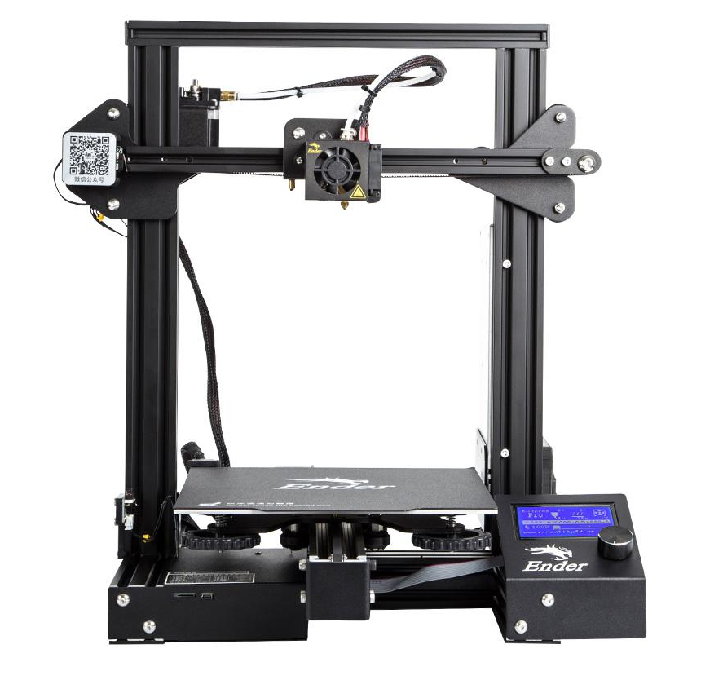
Recommended 3D Printers
Creality Ender 3 Pro
Retails at around $250
One of the most popular 3D printers available on the market
Relatively easy construction and doesn’t take long to set up
Because this is a ‘cheaper’ 3D printer, the quality and the endurance of the printer may suffer

Slide 16
Recommended 3D Printers
Prusa I3 MK3S
Retails at $750
One of the most popular 3D printers available on the market
Each part is tried-and-true and reliably works
This is one of the higher-end printers, although its sustainability and reliability dominates the market

Slide 17
Recommended Upgrades
Metal Extruder
Typically for the Ender 3 Pro
The plastic extruder on the E3P typically wears down after a few months of prolonged use
The aluminum extruder will not wear down, and stay consistent with e-step extrusion
Glass Bed
Different sizes for different printers
Easier to take prints off compared to a magnetic bed
Glossy finish on the bottom side of the print

Slide 18
Handy Tools
Calipers
Used to measure distance between two sides of an object accurately
Can measure outer diameter, inner diameter, and thickness
Helps with printer calibration
Flush Cutters
Useful for print cleanup
Can be used to remove excess 3D printed material or supports
One flush cutter comes in any Creality 3D Printer kit

Slide 19

Credits
This lesson was written by The Antidote 14320 for FTCTutorials.com
You can contact the author at:
Website:
http://theantidoterobotics.com
Twitter:
@theantidoteFTC
Email:
theantidoteftc@gmail.com
More lessons for FIRST Tech Challenge are available at www.FTCtutorials.com
This work is licensed under a
Creative Commons Attribution-NonCommercial-ShareAlike 4.0 International License.

